Slide 1
UNIT TESTING FOR FRONTEND CODE at Blibli.com
Irfan Maulana | Front End Developer

Slide 2
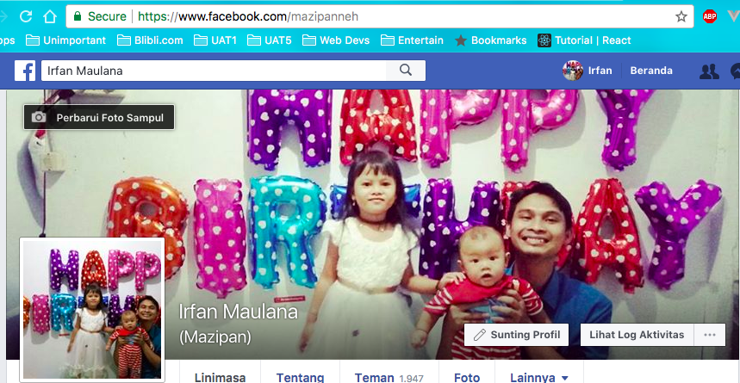
😎 About Me

Slide 3
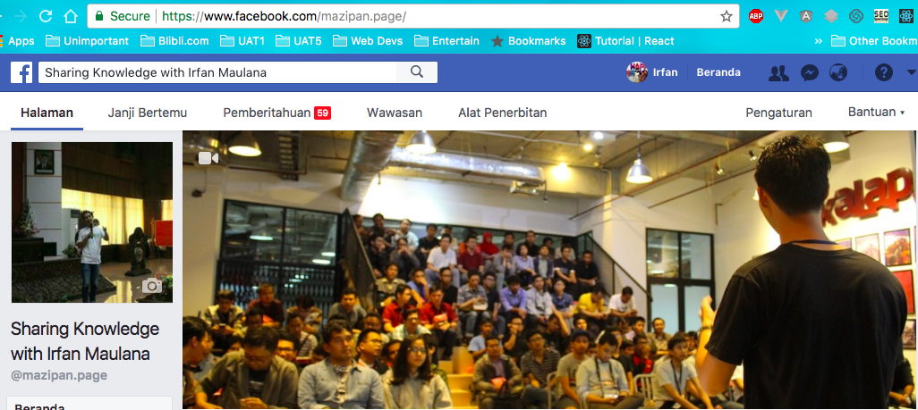
🤣 Fans ?

Slide 4
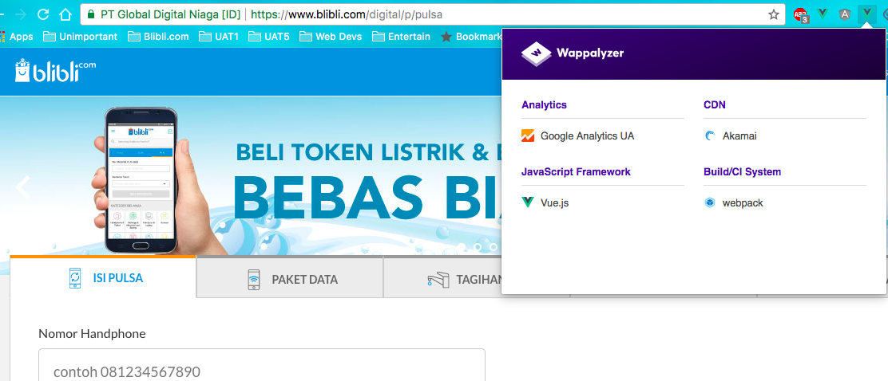
Blibli.com Frontend Code
⚔️ We believe in 💚 Green framework (*not 💙 Blue)

Slide 5

😱

Slide 6
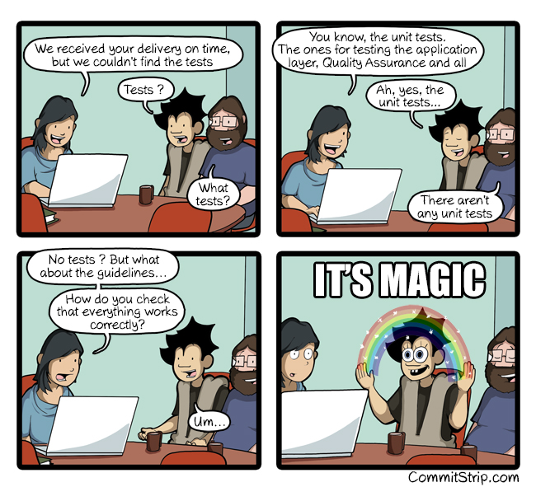
🤷‍♂️

Slide 7
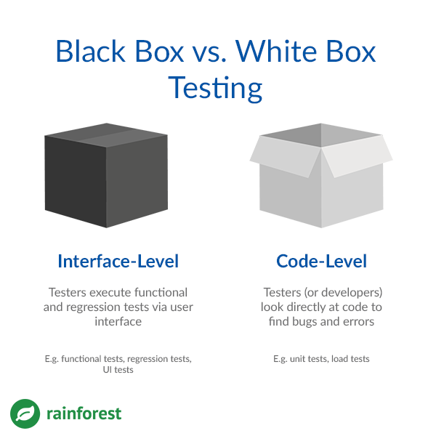
Blackbox vs Whitebox Testing

Slide 8


Blibli.com Frontend Unit Test Tools
karma runner
karma-mocha
karma-sinon-chai
karma-babel-preprocessor
Karma-coverage
karma-sourcemap-loader
karma-spec-reporter
karma-webpack
karma-phantomjs-launcher

Slide 9


Automate on Git Commit
Developer commit code
Automate run build and test
Run Code Analysis
Quality Passed ? ✅ : ⛔️

Slide 10
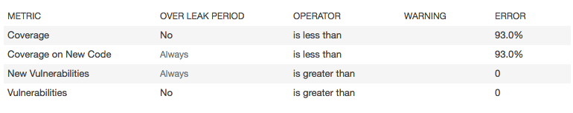

Quality Gate

Slide 11
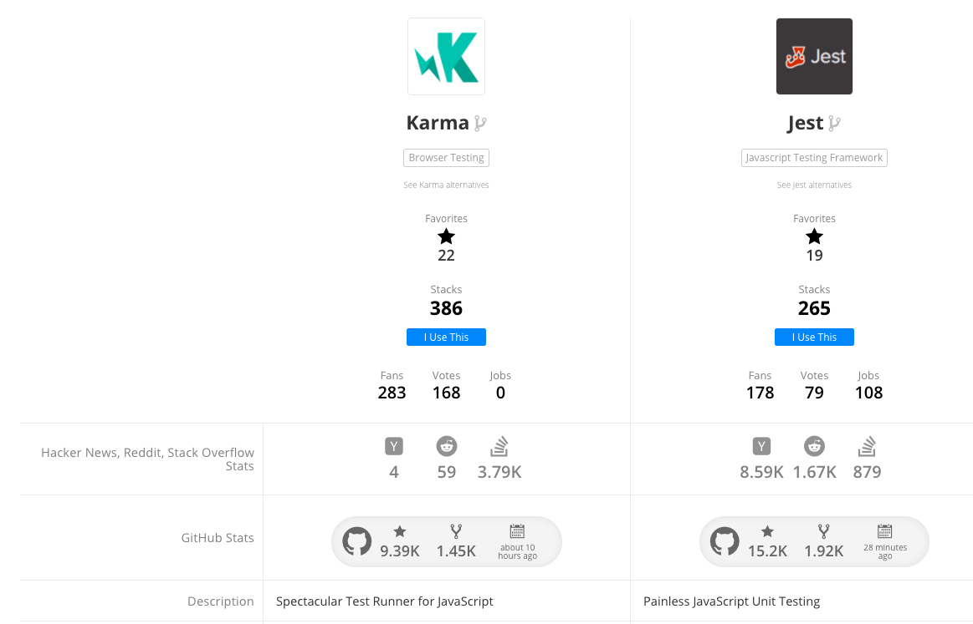
Karma vs Jest
https://stackshare.io/stackups/jest-vs-karma-runner update in January 26 2018

Slide 12
Let’s take a look the codes…
🛠

Slide 13
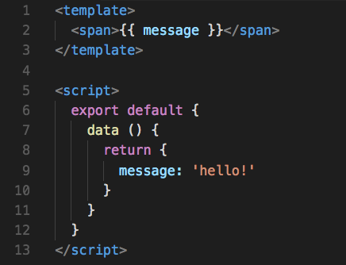

Vue Component

Slide 14
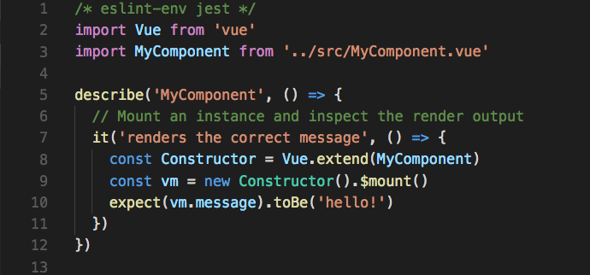
Unit Testing Vue Component

Slide 15
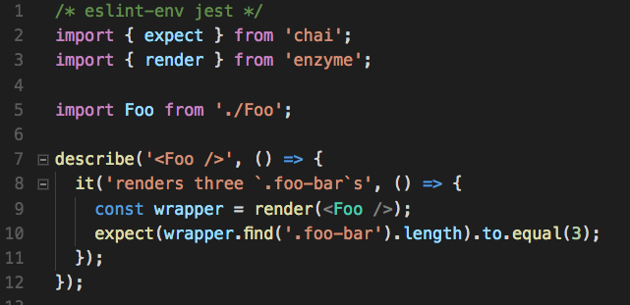


How (*Blue) Doing Unit Test ?

Slide 16
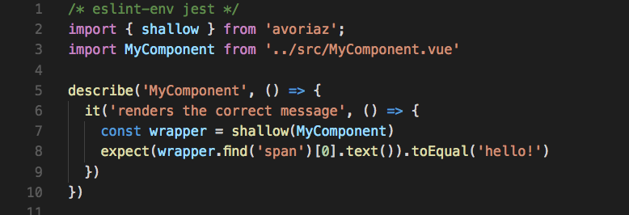
Vue Unit Test with 🔬 Avoriaz

Slide 17

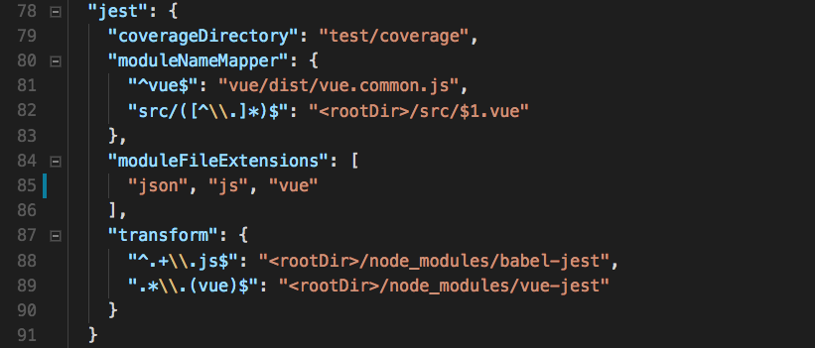
🃏 Jest-in-Vue

Slide 18
Space for Improvement (for Blibli.com)
Move from Karma to Jest – Simplify tooling
Add 🔬 Avoriaz / vue-test-utils – UI centric testing
End 2 End Test for Developer – Better quality delivery
Etc…

Slide 19
👍 Do you like my talks ?
🐙 https://github.com/mazipan
🎤 https://github.com/mazipan/talks
🎁 https://github.com/mazipan/project-catalog

